Slide 1
Hibernate Introduction
Dessign by: DieuNT1

Slide 2
Lesson Objectives
Describe the architecture and components of the Hibernate framework
Hibernate's benefits over using a JDBC connection
Use properties in the Hibernate Configuration file
Use Session, SessionFactory and Transaction
1
3
4
5
2
Understand what is Hibernate and when to used it?

Slide 3
Agenda
Hibernate Overview
Hibernate Features
Hibernate Architecture
Configuration
Hibernate First Example
Notes:
Overview: What is hibernate & high level architecture

Slide 4
Hibernate overview
Section 01

Slide 5
What is ORM?
ORM stands for Object-Relational Mapping (ORM), is a programming technique for converting data between relational databases and object oriented programming languages.
Java ORM Frameworks:
Hibernate
Spring DAO
Open JPA
Mybatis
Toplink
Notes:
Object - Relational mapping: Map object-oriented domain model to relational database
Persistence of associations and collections
Hibernate, open source ORM framework, widely used
Open JPA, Apache, open source, supports JPA API
Mybatis, free open source, formerly named iBATIS
Toplink by Oracle
ORM (Object Relational Mapping) framework là một cơ chế cho phép lập trình viên thao tác với database thông qua các đối tượng (không cần quan tâm loại database)

Slide 6
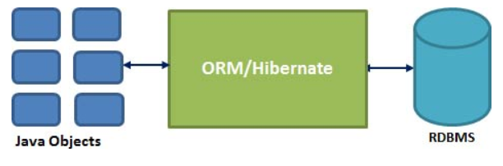
What is Hibernate?
Hibernate is an open source persistent framework, lightweight, ORM (Object Relational Mapping) tool solution for JAVA.
Hibernate is a Java framework that simplifies the development of Java application to interact with the database.
Hibernate implements the specifications of JPA (Java Persistence API) for data persistence.
Notes:
Object - Relational mapping: Map object-oriented domain model to relational database
Persistence of associations and collections

Slide 7
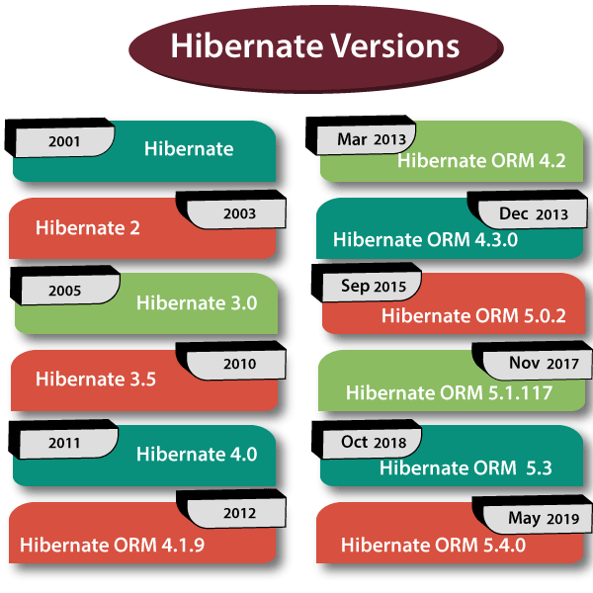
History of Hibernate
Hibernate was developed in 2001 by Gavin king with his colleagues from Circus Technologies.
https://www.tutorialandexample.com/

Slide 8
Hibernate Features
Section 02

Slide 9
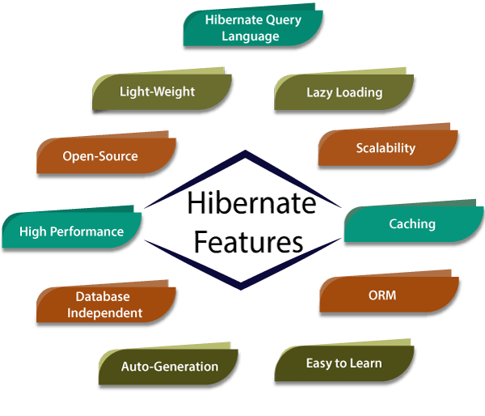
Features of Hibernate
Notes:
Theo thời gian, JDBC bộc lộ nhiều điểm yếu như:
Có nhiều code thừa mà chỉ phục vụ mục đích là lấy dữ liệu.
Mất nhiều thời gian map dữ liệu vào object Java.
Sẽ tốn nhiều công sức khi hệ thống thay đổi CSDL (yêu cầu jdbc mới, code mới)
Giao tiếp giữa các bảng thường khó, thiếu tính OOP trong đó.

Slide 10
Features of Hibernate
Lightweight
Hibernate is a lightweight framework as it does not contains additional functionalities; it uses only those functionalities required for object-relational mapping.
It is a lightweight framework because it uses persistent classes for data transfer between java application and databases.
Open Source
Hibernate is open-source software that means it is available for everyone without any cost.
It can be downloaded from its official website, http:// org/ . The latest version a user can download is Hibernate 5.4.

Slide 11
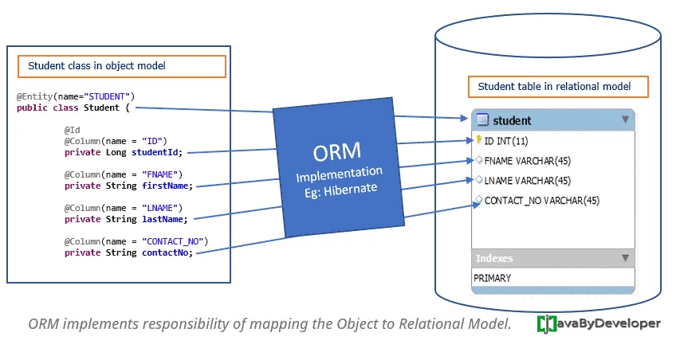
Features of Hibernate
ORM (Object Relation Mapping)
Hibernate is an ORM tool which helps in the interaction between the java classes and relational database.

Slide 12
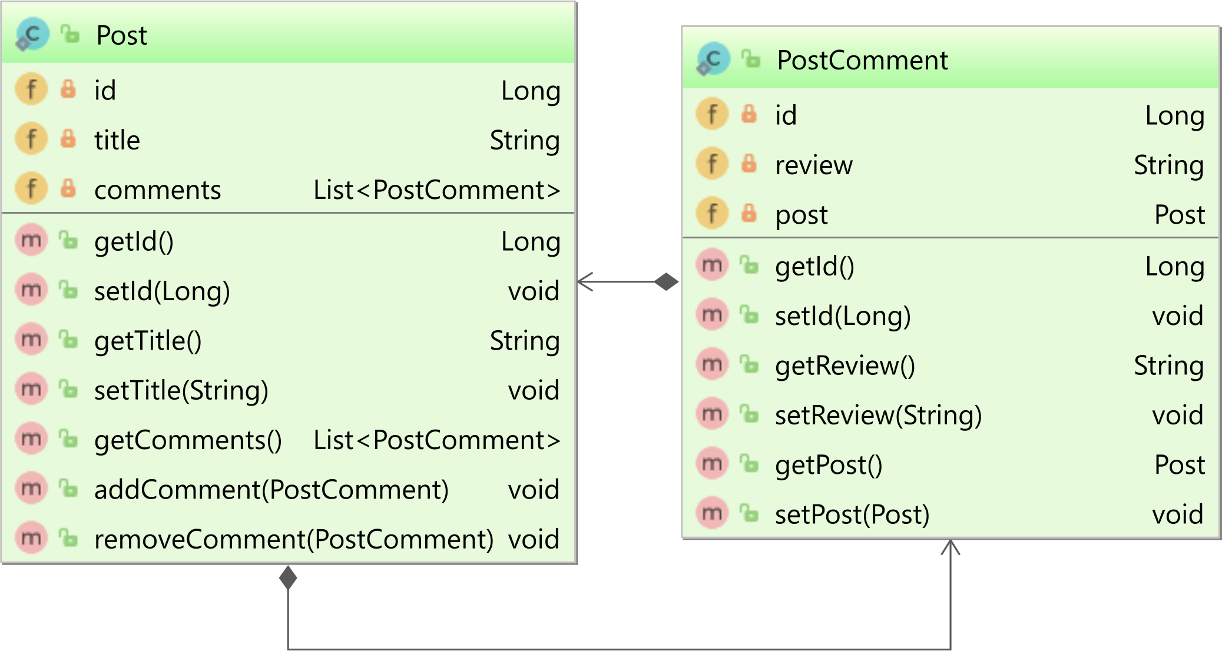
Features of Hibernate
High Performance
Hibernate supports many different fetching techniques such as, caching, lazy initialization, and many more to achieve high performance.
Can not load children (associated data)
(Associated data loads only when we explicitly call getter or size method.)

Slide 13
Features of Hibernate
HQL (Hibernate Query Language)
Hibernate has its query language, i.e., HQL (Hibernate Query Language) which is independent of the database.
HQL is an object-oriented language similar to SQL, but it works with the persistent object and its properties.
Query<User> query = session.createQuery(
"FROM User u WHERE u.userName = :userName "
+ "AND u.password = :password");
Enity name
(persistent object )
Properties
(persistent object properties)

Slide 14
Features of Hibernate
Caching
Hibernate supports two levels of caching, first-level and second-level caching.
Caching is the process of storing data into cache memory and improves the speed of data access.
Auto-Generation
Hibernate provides a feature of automatic table generation.
Scalability
Hibernate is highly scalable as it can be fit in any environment. Hibernate can be used for both small scale and large scale applications.

Slide 15
Features of Hibernate
Lazy Loading
Hibernate supports a new concept called lazy loading. Lazy loading concept retrieves the only necessary object for execution.
Easy to learn
Hibernate is easy to learn and implement.
Database Independent
Hibernate is database-independent as it provides ‘Database Dialect’ so we need not write SQL queries.
It supports many databases such as Oracle, MySql, Sybase, SQL Server, etc.

Slide 16
Hibernate Architecture
Section 03

Slide 17
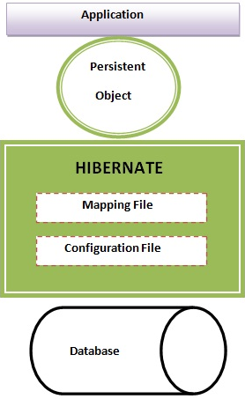
High Level Architecture
Notes:
Persistent objects are the classes that in your program that has a representation in the database

Slide 18
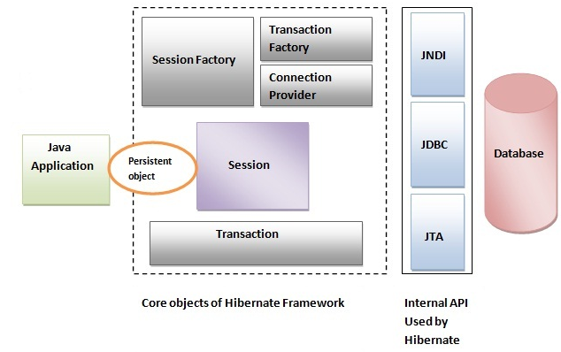
Core Components of Hibernate
Hibernate framework uses many objects session factory, session, transaction etc. along with existing Java API such as JDBC (Java Database Connectivity), JTA (Java Transaction API) and JNDI (Java Naming Directory Interface).

Slide 19
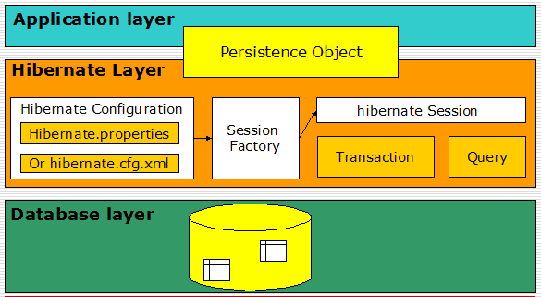
Core Components of Hibernate

Slide 20
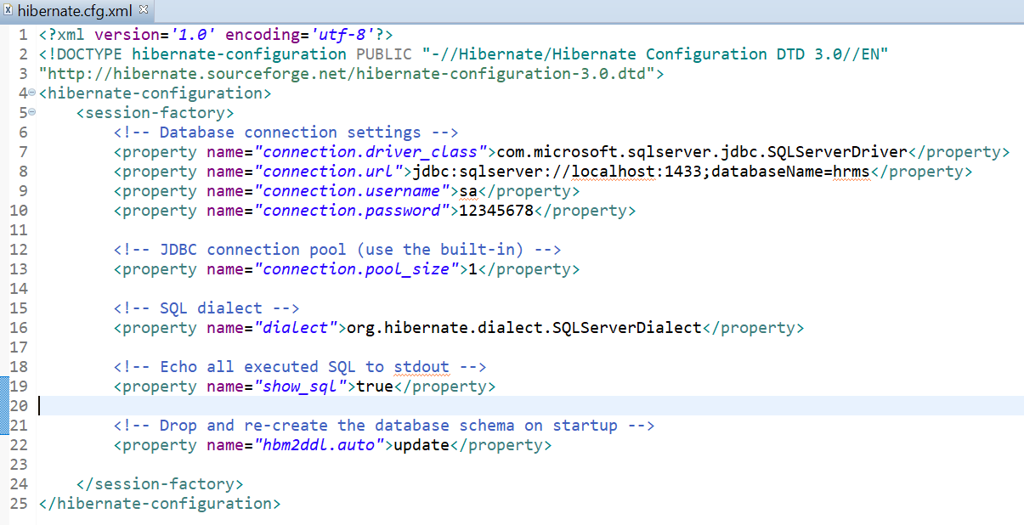
Core Components of Hibernate
Configuration
In package: org. cfg
The Configuration class consists of the properties and function files of
It reads both mapping and configuration file.
Syntax:
Configuration cfg = new Configuration();
cfg.configure();
Notes:
Câu hỏi: đối tượng configuration được tạo khi nào
➔ The configuration object is created only once during the application initialization.

Slide 21
Core Components of Hibernate
SessionFactory
The org. sessionFactory package contains the SessionFactory interface whose object can be obtained by the object of Configuration class.
It is a threadsafe object and used by all the threads in the application.
Syntax:
Or
It takes the JDBC information from cfg object and creates a JDBC connection. It provides factory method to get the object of Session.
SessionFactory sessionFactory = cfg.buildSessionFactory();
ServiceRegistry serviceRegistry = new StandardServiceRegistryBuilder().
applySettings(cfg.getProperties()).build();
SessionFactory sessionFactory = cfg.buildSessionFactory(serviceRegistry);
Notes:
SessionFactory là đối tượng chứa các thông tin quan trọng để thực hiện tạo kết nối đến database như: mapping, data source, các connection information khác... Do đó việc tạo đối tượng này rất tốn công. Đây chính là lý do chỉ có một session factory cho một application.

Slide 22
Core Components of Hibernate
SessionFactory methods:
SessionFactory provides three methods through which we can get Session object:
openSession(): method always opens a new session. We should close this session object once we are done with all the database operations.
getCurrentSession(): method returns the session bound to the context. Need to have configured in hibernate configuration file like following:
<property name="current_session_context_class">thread</property>
It’s faster than opening a new session
Notes:
For web application frameworks, we can choose to open a new session for each request or for each session based on the requirement.

Slide 23
SessionFactory class
SessionFactory methods:
openStatelessSession(): method returns instance of StatelessSession.
StatelessSession in Hibernate does not implement first-level cache and it doesn’t interact with any second-level cache.
Collections are also ignored by a stateless session.
It’s more like a normal JDBC connection and doesn’t provide any benefits that come from using hibernate framework.
Notes:
However, stateless session can be a good fit in certain situations. For example where we are loading bulk data into database and we don’t want hibernate session to hold huge data in first-level cache memory.
A simple program showing Hibernate SessionFactory methods usage is given below.
That’s all for SessionFactory in Hibernate and it’s different methods to obtain session object.

Slide 24
Core Components of Hibernate
Session
The session object provides an interface between the application and data stored in the database. A Session is used to get a physical connection with a database.
Persistent objects are saved and retrieved through a Session object.
The session objects should not be kept open for a long time because they are not usually thread safe and they should be created and destroyed them as needed.
It is factory of Transaction, Query and Criteria.
It holds a first-level cache (mandatory) of data.
The org. Session object is not threadsafe. It is used to execute CRUD operations (insert, delete, update, edit).
Syntax:
Session session = sessionFactory.openSession();
Notes:
SessionFactory là đối tượng chứa các thông tin quan trọng để thực hiện tạo kết nối đến database như: mapping, data source, các connection information khác... Do đó việc tạo đối tượng này rất tốn công. Đây chính là lý do chỉ có một session factory cho một application.

Slide 25
Core Components of Hibernate
Transaction
The org.hibernate package contains a Transaction interface.
The object of the session creates a Transaction object.
It provides the instruction to the database for transaction management.
It is a short-lived single-threaded object.
Transaction transaction = session.beginTransaction();
Serializable result = session.save(job);
transaction.commit();
Notes:
Atomicity tức là tính Nguyên tố: Thuộc tính này đảm bảo mỗi transaction là một khối duy nhất, được thực hiện trọn vẹn hoặc hoàn toàn không được thực hiện. Nếu có một lỗi nào đó xảy ra trong transaction, nó sẽ được quay trở lại (rollback) trạng thái ban đầu. Khi bạn gom nhiều lệnh vào một transaction (bao giữa BEGIN TRAN và COMMIT), sẽ chỉ có hai khả năng được phép xảy ra là, tất cả các lệnh này sẽ được thực hiện hoặc không có lệnh nào được thực hiện. Ở mức từng lệnh, SQL Server cũng đảm bảo tính atomicity, ví dụ một lệnh INSERT cho 10 bản ghi, nếu đang thêm được 5 bản ghi thì gặp lỗi, hệ thống sẽ hủy bỏ và không bản ghi nào được thêm. Nếu lệnh có kèm theo trigger, lỗi ở trigger cũng kéo theo lệnh bị hủy bỏ. Khi bạn phát ra lệnh ROLLBACK, tất cả các lệnh đã thực hiện cũng bị quay lui và transaction trở lại trạng thái như trước khi thực hiện.

Slide 26
Configuration
Section 04

Slide 27
Introduction
How your Java classes relate to the database tables?
Hibernate requires a set of configuration settings related to database and other related parameters.
All such information is usually supplied as a standard Java properties file called properties, or as an XML file named cfg.xml.
We will consider XML formatted file cfg.xml to specify required Hibernate properties in all of examples.

Slide 28
cfg.xml
<?xml version='1.0' encoding='utf-8'?>
<!DOCTYPE hibernate-configuration PUBLIC "-//Hibernate/Hibernate Configuration DTD 3.0//EN“
"http:// sourceforge.net/hibernate-configuration-3.0.dtd">
<hibernate-configuration>
<session-factory>
<!-- Database connection settings -->
<property name="connection.driver_class">com.microsoft.sqlserver.jdbc.SQLServerDriver</property>
<property name="connection.url">jdbc:sqlserver://localhost:1433;databaseName=hrms</property>
<property name="connection.username">sa</property>
<property name="connection.password">12345678</property>
<!-- JDBC connection pool (use the built-in) -->
<property name="connection.pool_size">1</property>
<!-- SQL dialect -->
<property name="dialect">org. dialect.SQLServerDialect</property>
<!-- Echo all executed SQL to stdout -->
<property name="show_sql">true</property>
<!-- Drop and re-create the database schema on startup -->
<property name="hbm2ddl.auto">update</property>
</session-factory>
</hibernate-configuration>
Database connection setting: driver, url, username, password
The dialect corresponding to the database vendor
Notes:
driver_class: com.microsoft.sqlserver.jdbc.SQLServerDriver
url: jdbc:sqlserver://localhost:1433;databaseName=SMS
username: sa
password: 12345678
dialect: org. dialect.SQLServerDialect
Mỗi loại database lại có những cú pháp, extensions riêng. Để làm việc với các loại database khác nhau như thế, hibernate sử dụng tham số “Dialect” để biết được loại database nào đang được sử dụng, như thế các câu lệnh SQL được sinh ra sẽ phù hợp với database.

Slide 29
Properties of Hibernate Configuration
Hibernate JDBC Properties
Hibernate Configuration Properties
Property | Description
connection.driver_class | It represents the JDBC driver class.
connection.url | It represents the JDBC URL.
connection.username | It represents the database username.
connection.password | It represents the database password.
connection.pool_size | It represents the maximum number of connections available in the connection pool.
Property | Description
hibernate.dialect | It represents the type of database used in hibernate to generate SQL statements for a particular relational database.
hibernate.show_sql | It is used to display the executed SQL statements to console.

Slide 30
Properties of Hibernate Configuration
Other Hibernate Properties
Property | Description
hbm2ddl.auto | It automatically generates a schema in the database with the creation of SessionFactory: create: the hibernate first drops the existing tables data and structure, then creates new tables and executes the operations on the newly created tables. validate: hibernate only validates the table structure- whether the table and columns have existed or not. If the table doesn’t exist then hibernate throws an exception. update: Hibernate checks for the table and columns. If a table doesn’t exist then it creates new tables and where as if a column doesn’t exist it creates new columns for it create-drop: Hibernate first checks for a table and do the necessary operations and finally drops the table after all the operations were completed.

Slide 31
Hibernate First Example
Section 05

Slide 32
Steps to create first Hibernate Application
Create the Java maven Project
Add all required dependencies for hibernate
Create the Persistent class
Create the mapping file for Persistent class
Create the Configuration file
Create the class that retrieves or stores the persistent object
Run the application

Slide 33
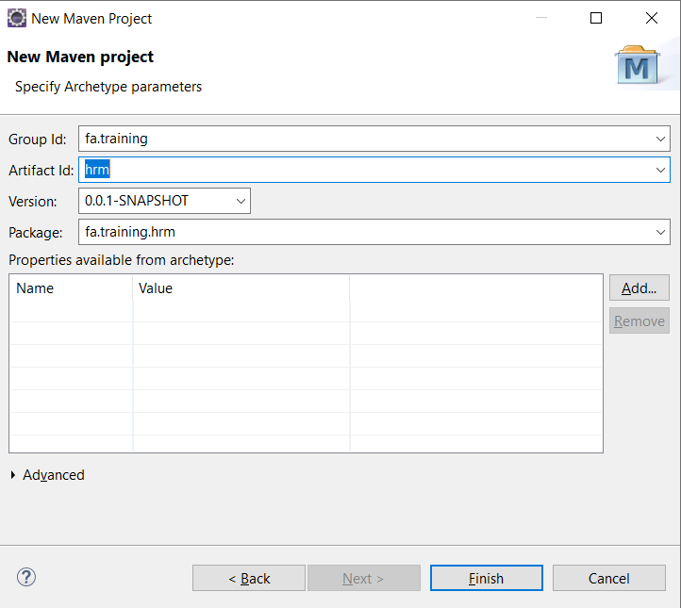
Create a Java Maven Project
Create a new quickstart Maven project named "hrm":

Slide 34
Add hibernate dependency
<dependencies>
<dependency>
<groupId>org.hibernate</groupId>
<artifactId>hibernate-core</artifactId>
<version>5.4.12.Final</version>
</dependency>
<dependency>
<groupId>com.microsoft.sqlserver</groupId>
<artifactId>mssql-jdbc</artifactId>
<version>7.4.1.jre8</version>
</dependency>
</dependencies>
<build>
<finalName>hrms</finalName>
<plugins>
<plugin>
<groupId>org.apache.maven.plugins</groupId>
<artifactId>maven-compiler-plugin</artifactId>
<version>3.1</version>
<configuration>
<source>1.8</source>
<target>1.8</target>
</configuration>
</plugin>
</plugins>
</build>

Slide 35
Create the POJO /Persistent/Bean class
@Entity
@Table(schema = "dbo", name = "Jobs")
public class Jobs {
@Id
@Column(name = "job_id", length = 10)
private String jobId;
@Column(name = "job_title", length = 255, nullable = false, unique = true)
private String jobTitle;
@Column(name = "min_salary", precision = 11, scale = 2)
private double minSalary;
@Column(name = "min_salary", precision = 11, scale = 2)
private double maxSalary;
public Jobs() {
}
public Jobs(String jobId, String jobTitle, double minSalary,
double maxSalary) {
super();
this.jobId = jobId;
this.jobTitle = jobTitle;
this.minSalary = minSalary;
this.maxSalary = maxSalary;
}
//getter and setter methods

Slide 36
Create a Configuration file
<?xml version='1.0' encoding='utf-8'?>
<!DOCTYPE hibernate-configuration PUBLIC "-//Hibernate/Hibernate Configuration DTD 3.0//EN"
"http:// sourceforge.net/hibernate-configuration-3.0.dtd">
<hibernate-configuration>
<session-factory>
<!-- Database connection settings -->
<property name="connection.driver_class">com.microsoft.sqlserver.jdbc.SQLServerDriver</property>
<property name="connection.url">jdbc:sqlserver://localhost:1433;databaseName=hrms</property>
<property name="connection.username">sa</property>
<property name="connection.password">12345678</property>
<!-- JDBC connection pool (use the built-in) -->
<property name="connection.pool_size">1</property>
<!-- SQL dialect -->
<property name="dialect">org. dialect.SQLServerDialect</property>
<!-- Echo all executed SQL to stdout -->
<property name="show_sql">true</property>
<!-- Drop and re-create the database schema on startup -->
<property name="hbm2ddl.auto">update</property>
<mapping class="fa.training.entities.Jobs" />
</session-factory>
</hibernate-configuration>

Slide 37
Create a HibernateUtils class
public class HibernateUtils {
private static SessionFactory sessionFactory;
static {
// Create a new Configuration object
Configuration cfg = new Configuration();
cfg.configure();
// Get the SessionFactory object from Configuration
if (sessionFactory == null) {
sessionFactory = cfg.buildSessionFactory();
}
}
public static SessionFactory getSessionFactory() {
return sessionFactory;
}
}

Slide 38
Create a DAO class
public class JobDaoImpl implements JobDao {
@Override
public boolean save(Jobs job) throws Exception {
Session session = null;
Transaction transaction = null;
try {
session = HibernateUtils.getSessionFactory().openSession();
transaction = session.beginTransaction();
Serializable result = session.save(job);
transaction.commit();
return (result != null);
} finally {
if (session != null) {
session.close();
}
}
}
}

Slide 39
Create a Unit Test Script
Create a UT Script to test the above DAO method
class JobDaoTest {
static JobDao jobDao;
@BeforeAll
static void setUpBeforeClass() throws Exception {
jobDao = new JobDaoImpl();
}
@Test
void testSave1() throws Exception {
Jobs job = new Jobs("J01", "Java Dev1", 1000, 2000);
assertEquals(true, jobDao.save(job));
}
@Test
void testSave2() throws Exception {
Jobs job = new Jobs("J02", "Java Dev2", 1200, 2200);
assertEquals(true, jobDao.save(job));
}
}

Slide 40
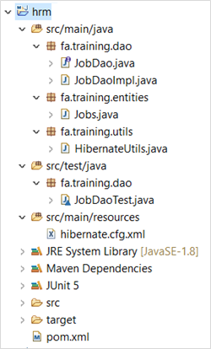
Project Structure

Slide 41
Results
Oct 04, 2020 12:06:22 PM org.hibernate.Version logVersion
INFO: HHH000412: Hibernate ORM core version 5.4.12.Final
Oct 04, 2020 12:06:22 PM org.hibernate.annotations.common.reflection.java.JavaReflectionManager <clinit>
INFO: HCANN000001: Hibernate Commons Annotations {5.1.0.Final}
Oct 04, 2020 12:06:23 PM org.hibernate.engine.jdbc.connections.internal.DriverManagerConnectionProviderImpl configure
WARN: HHH10001002: Using Hibernate built-in connection pool (not for production use!)
Oct 04, 2020 12:06:23 PM org.hibernate.engine.jdbc.connections.internal.DriverManagerConnectionProviderImpl buildCreator
INFO: HHH10001005: using driver [com.microsoft.sqlserver.jdbc.SQLServerDriver] at URL [jdbc:sqlserver://localhost;databaseName=hrms]
Oct 04, 2020 12:06:23 PM org.hibernate.engine.jdbc.connections.internal.DriverManagerConnectionProviderImpl buildCreator
INFO: HHH10001001: Connection properties: {user=sa, password=****}
Oct 04, 2020 12:06:23 PM org.hibernate.engine.jdbc.connections.internal.DriverManagerConnectionProviderImpl buildCreator
INFO: HHH10001003: Autocommit mode: false
Oct 04, 2020 12:06:23 PM org.hibernate.engine.jdbc.connections.internal.DriverManagerConnectionProviderImpl$PooledConnections <init>
INFO: HHH000115: Hibernate connection pool size: 1 (min=1)
Oct 04, 2020 12:06:23 PM org.hibernate.dialect.Dialect <init>
INFO: HHH000400: Using dialect: org.hibernate.dialect.SQLServer2012Dialect
Oct 04, 2020 12:06:24 PM org.hibernate.resource.transaction.backend.jdbc.internal.DdlTransactionIsolatorNonJtaImpl getIsolatedConnection
INFO: HHH10001501: Connection obtained from JdbcConnectionAccess [org.hibernate.engine.jdbc.env.internal.JdbcEnvironmentInitiator$ConnectionProviderJdbcConnectionAccess@773e2eb5] for (non-JTA) DDL execution was not in auto-commit mode; the Connection 'local transaction' will be committed and the Connection will be set into auto-commit mode.
Hibernate: create table dbo.Jobs (jobId varchar(255) not null, job_title varchar(255) not null, max_salary double precision, min_salary double precision, primary key (jobId))
Hibernate: alter table dbo.Jobs drop constraint UK_hiqsn2scso4em9j18jb24ioo8
Hibernate: alter table dbo.Jobs add constraint UK_hiqsn2scso4em9j18jb24ioo8 unique (job_title)
Oct 04, 2020 12:06:25 PM org.hibernate.engine.transaction.jta.platform.internal.JtaPlatformInitiator initiateService
INFO: HHH000490: Using JtaPlatform implementation: [org.hibernate.engine.transaction.jta.platform.internal.NoJtaPlatform]
Hibernate: insert into dbo.Jobs (job_title, max_salary, min_salary, jobId) values (?, ?, ?, ?)
Hibernate: insert into dbo.Jobs (job_title, max_salary, min_salary, jobId) values (?, ?, ?, ?)

Slide 42
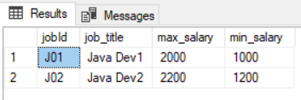
Results
The result after selecting Jobs table.

Slide 43
Summary
Hibernate Overview
Hibernate Features
Hibernate Architecture
Configuration
Hibernate First Example
Notes:
Overview: What is hibernate & high level architecture

Slide 44
THANK YOU!
Q & A

